Slide 1

All for one one for All
Author: Bamshad Shirmohammadi
Supervisor: Professor Arend Hintze

Slide 2

Overview
1. Introduction (problem statement and research aim)
2. Research methodology
3. Results
4. Conclusion

Slide 3
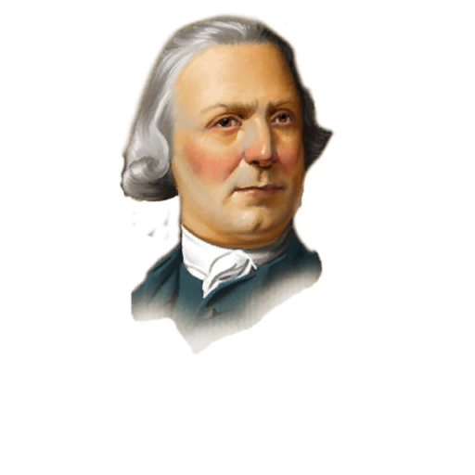
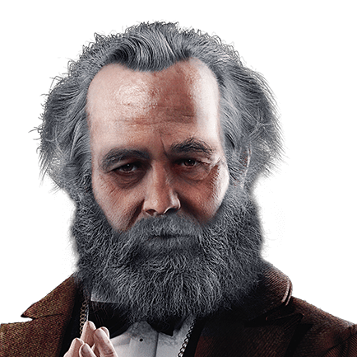
Introduction
Imagine a school which all the students help the weakest one!
It is a Beautiful dream!
By the way, I am going to establish one of the best schools in the real world!
Can we find a common ground?
WE

Slide 4
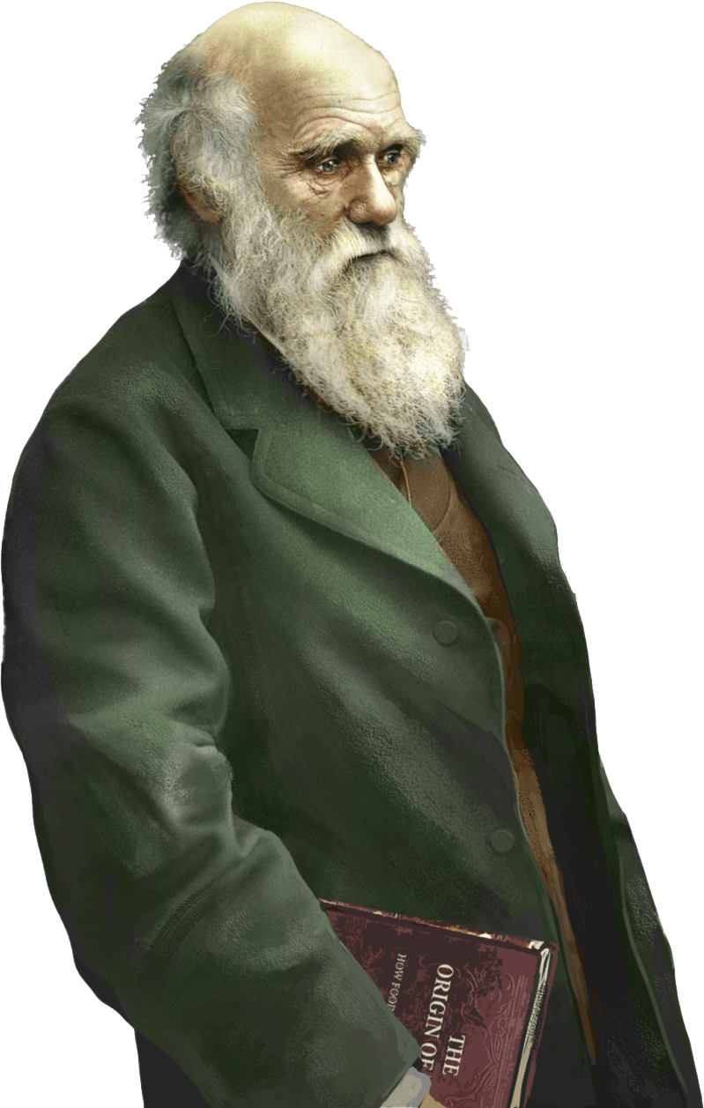
Evolvable artificial robots? I am confused!
Introduction
We: Yes, it is a bit far fetching in the world of humans but, we are going to do it in world of Artificial Intelligence
You: how?
We: We will train a group of AI controllers (agents) to perform better individually and in teams at the same time.
For this propose we have used a framework called MABE for creating evolvable artificial robots!

Slide 5
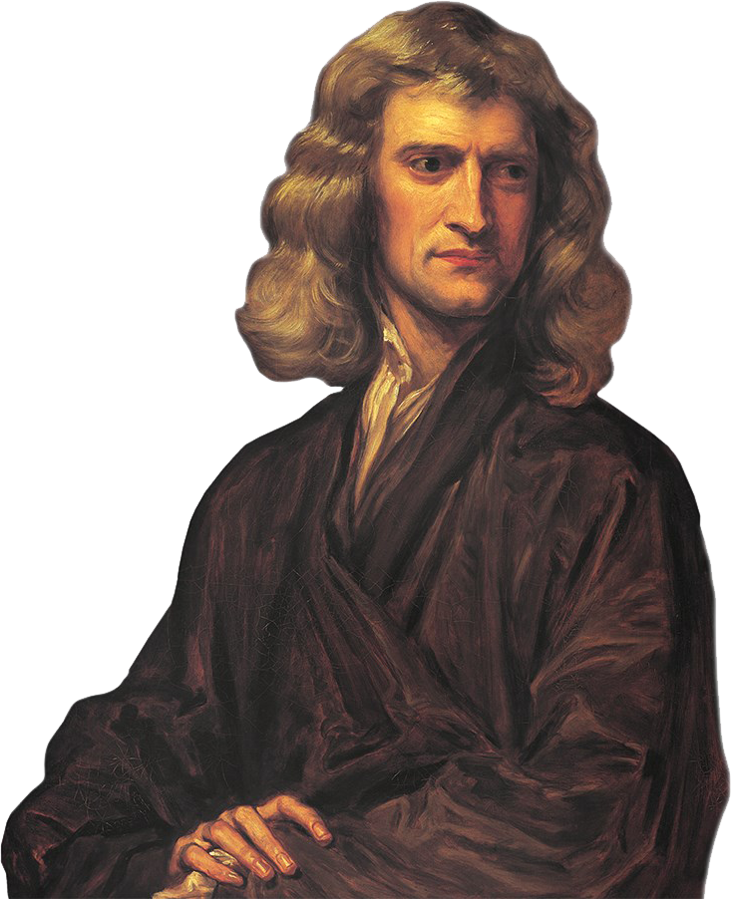
"If I have seen further it is by standing on the shoulders of Giants.”
Methodology
MABE creates and manages populations of evolving digital organisms which are evaluated in worlds. Using the results of the evaluations new populations are generated by means of natural, artificial, and/or sexual selection.

Slide 6

Methodology
Group mode:
clonal
and not clonal
Reward sachem:
Individual,
maximum,
minimum,
and average.
Research gap

Slide 7
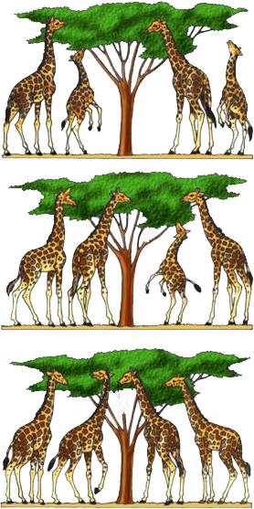
Natural selection
Our artificial natural selection
Individual: The one who gain more scores has higher chance to reproduce.
Minimum:
Maximum:
Average:
Methodology

Slide 8
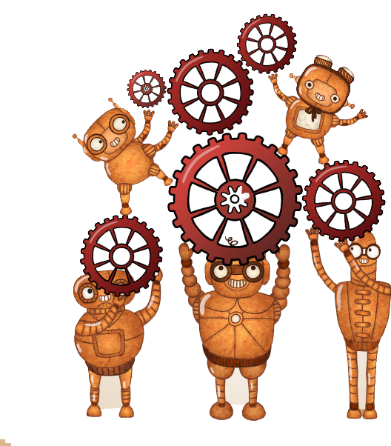
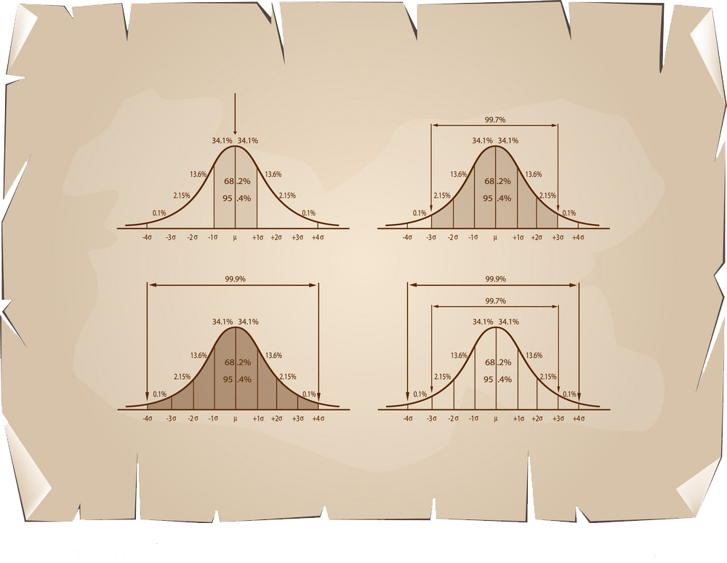
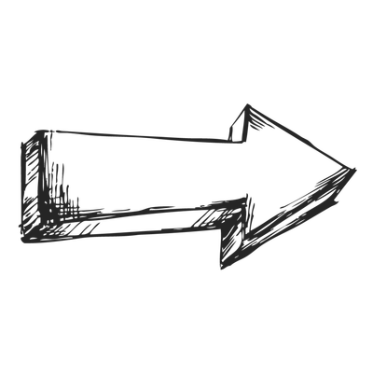


Methodology
Generation id score
1 14
. . .
. . .
. . .
5000 20000 40

Slide 9
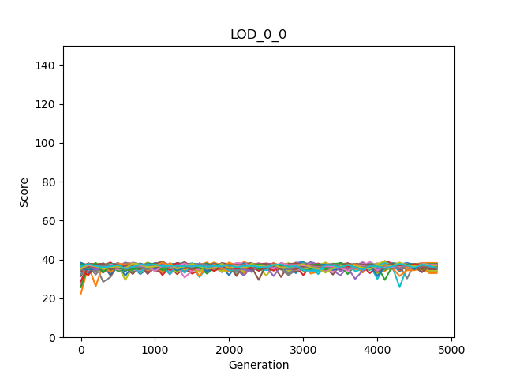
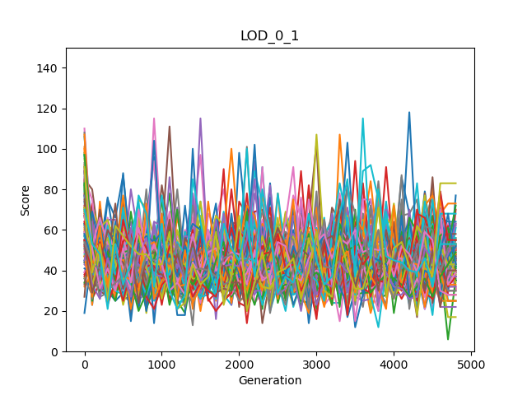
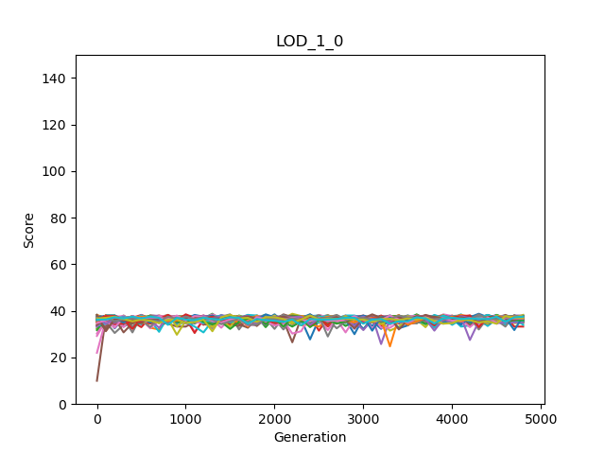
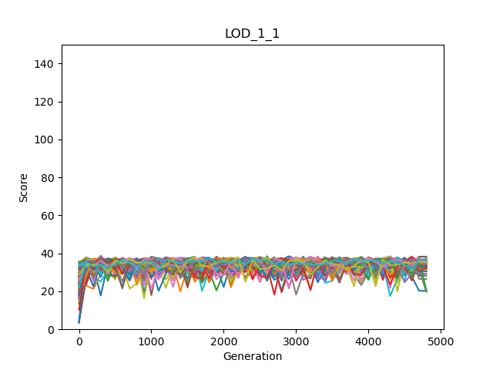
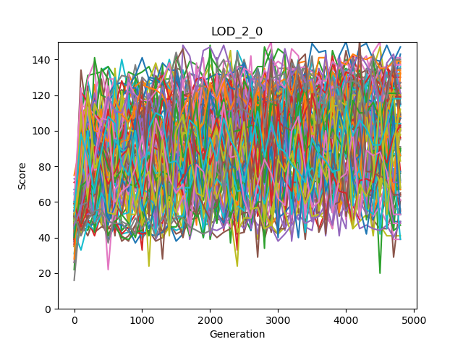
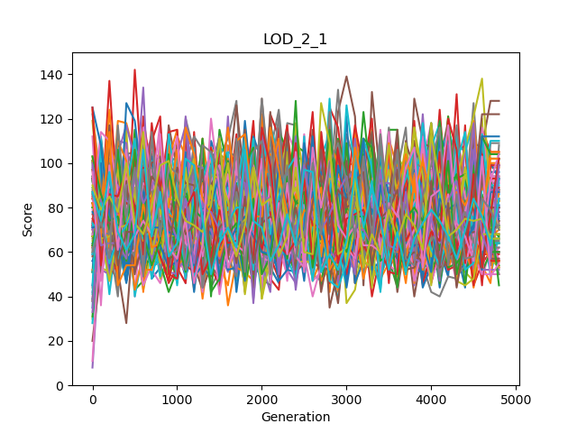
Results
Individual | Clone
Individual | Not Clone
Mean | Clone
Mean | Not Clone
Maximum | Clone
Maximum | Not Clone
Minimum | Clone
Minimum | Not Clone

Slide 10



So, the Marx’ dream and my ideas are both satisfied?
Results
rewardGroupModes | Mean OwnScores | Mean Minimums | Mean Maximums | Mean Averages | Mean Sums
LOD_0_0 Group mode: Clone Reward mode: Individual | 36.4275510 | 26.0175510 | 47.4516326 | 36.4275510 | 145.710204
LOD_0_1 3 Group mode: Not Clone Reward mode: Individual | 44.7497959 | 20.1351020 | 52.0906122 | 36.5244898 | 146.097959
LOD_1_0 2 Group mode: Clone Reward mode: Average | 36.4372959 | 25.8336734 | 47.5702040 | 36.4372959 | 145.749183
LOD_1_1 Group mode: Not clone Reward mode: Average | 47.0285714 | 11.6457142 | 56.7748979 | 33.9260204 | 135.704081
LOD_2_0 Group mode: Clone Reward mode: Maximum | 91.9987755 | 2.70897959 | 91.9987755 | 30.8365306 | 123.346122
LOD_2_1 Group mode: Not clone Reward mode: Maximum | 67.5675510 | 1.56244898 | 75.5930612 | 31.0185204 | 124.074081
LOD_3_0 1 Group mode: Clone Reward mode: Minimum | 30.7763265 | 30.7763265 | 42.3973469 | 36.4311734 | 145.724693
LOD_3_1 Group mode: Not clone Reward mode: Minimum | 34.1008163 | 23.0051020 | 44.5406122 | 33.0433673 | 132.173469
For Markov Brain Agents, yes!
WE

Slide 11
a) We have identified that there is a relationship between agents' scores and their actions (beep, do nothing, and giving food to others or empty tiles). In general, communication or usage of beep causes better performance for the agents when coordination is needed
Results
We did more than enough!
b) When we set rewarding schemes to minimum, maximum, and average, the clones perform better, whereas non-clones are better adapting under the individual reward schemes
WE
c) The high variance in the agents' scores through the generations causes better performance at the end.

Slide 12
Using clonal agents and minimum rewarding scheme we could train a group of AI controllers (agents) to perform better individually and in teams at the same time.
Beyond the initial thesis aim we have investigated three more aspects that are: a) comparison of clonal and non clonal groups, b) effect of agents' actions on their performance and c) effect of the variance in the agents' scores through the generations on their performance.
Conclusion

Slide 13
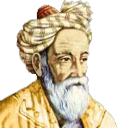
Question everything
Thank you

